Slide 1
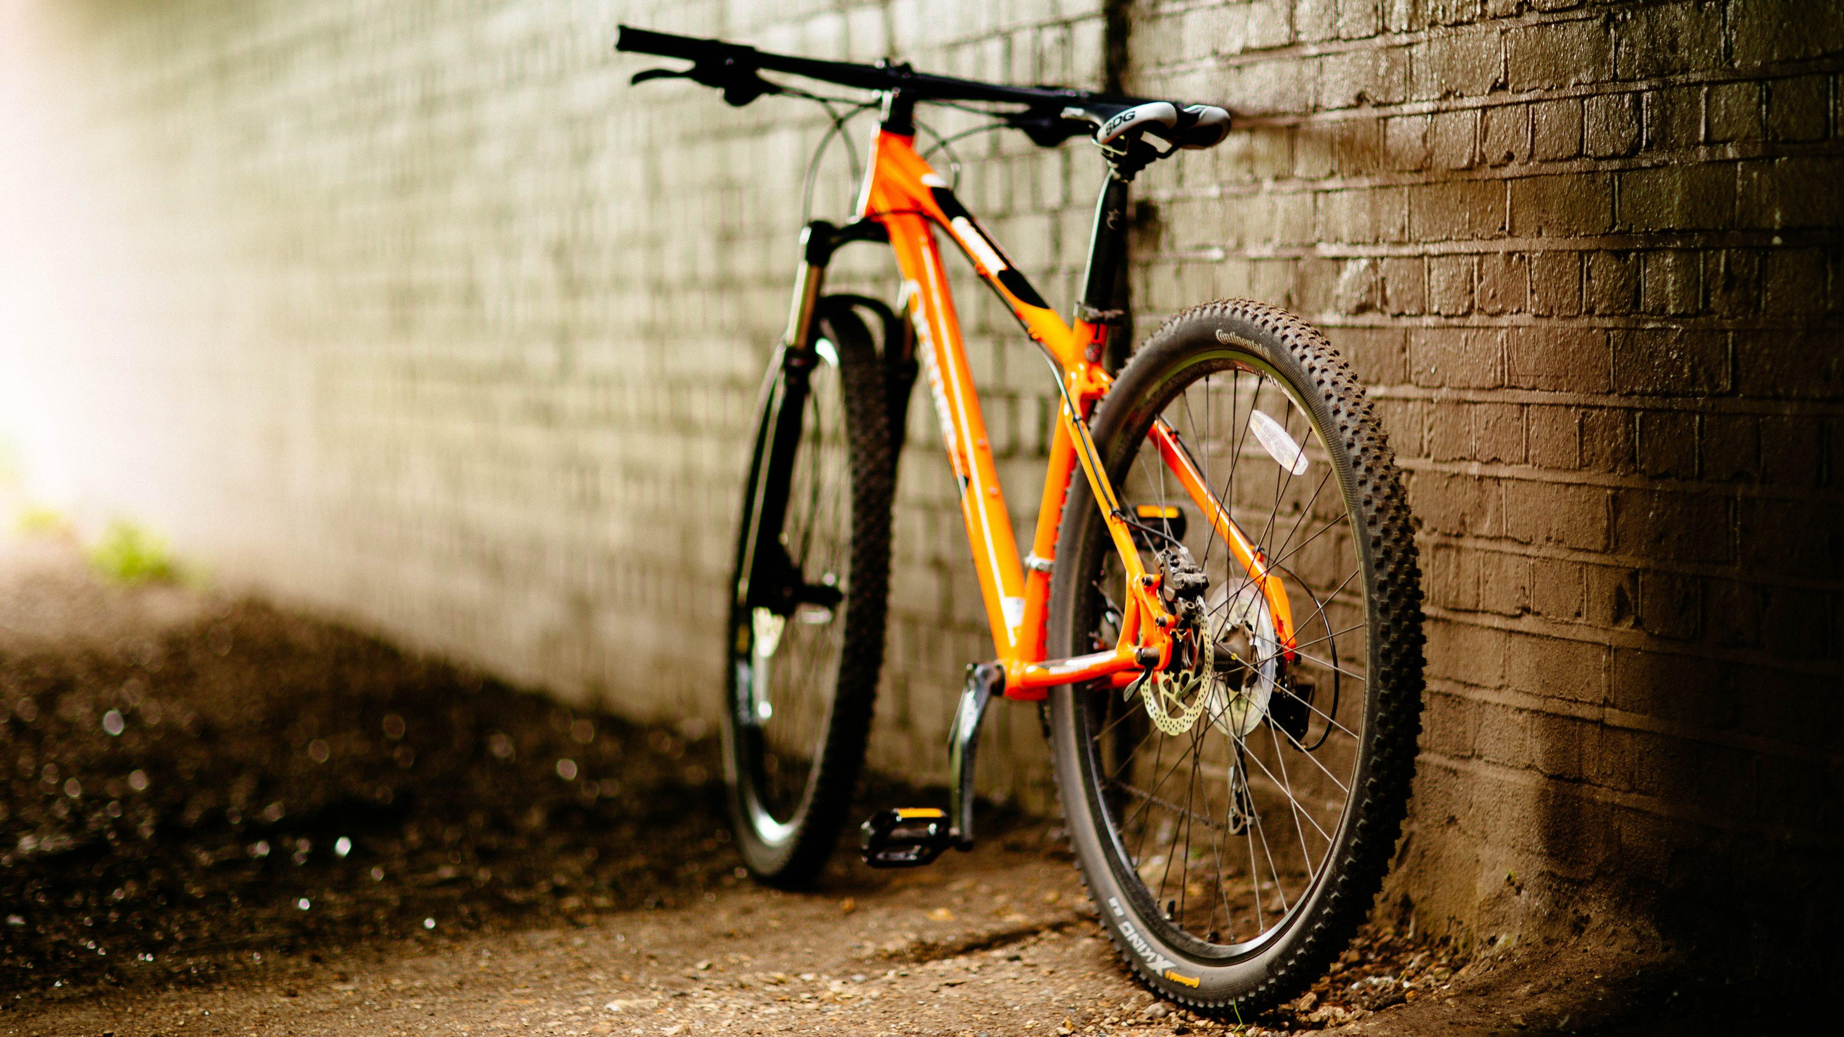
Biking Company
Customers and Sales Analysis
Rio Guo | Yunpeng Hou | Yijie Zhao

Slide 2
Objectives
Boulder Expeditions is an online Biking company focused on Mountain and Touring bikes.
The company takes a data-driven approach to examine and organize data with the goal of better serving customers.
Unsupervised Model – K-Means
Target marketing based on customer segmentation
1
2
Supervised Model: Regression
Predict customer behavior for potential purchases
3
Supervised Model: Classification
Create a product recommendation system

Slide 3
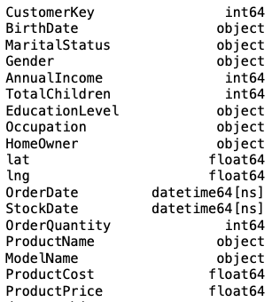

Data Understanding
18 Columns
Select
Transactions
Related to Bicycles
Customer Demographic
56K
Order Information
Transactions

Slide 4
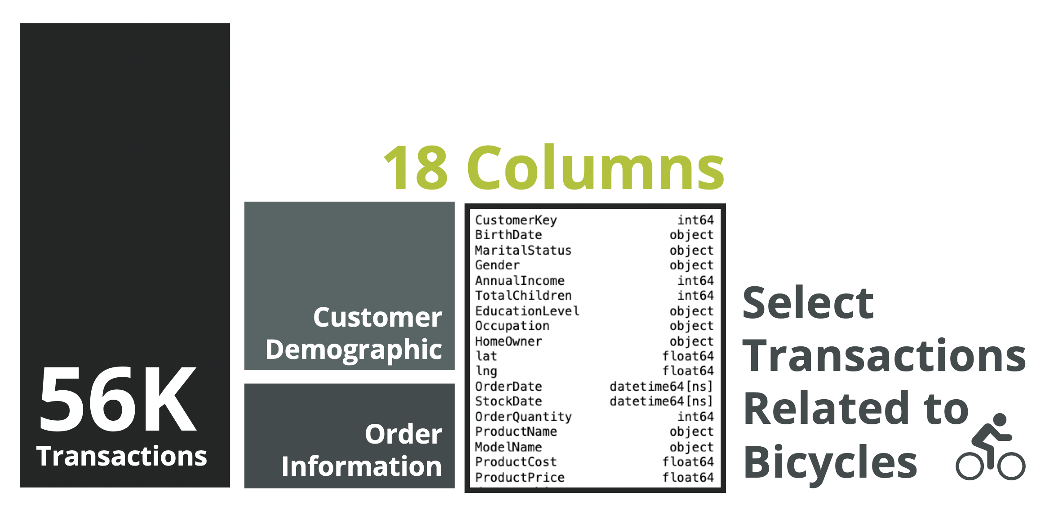
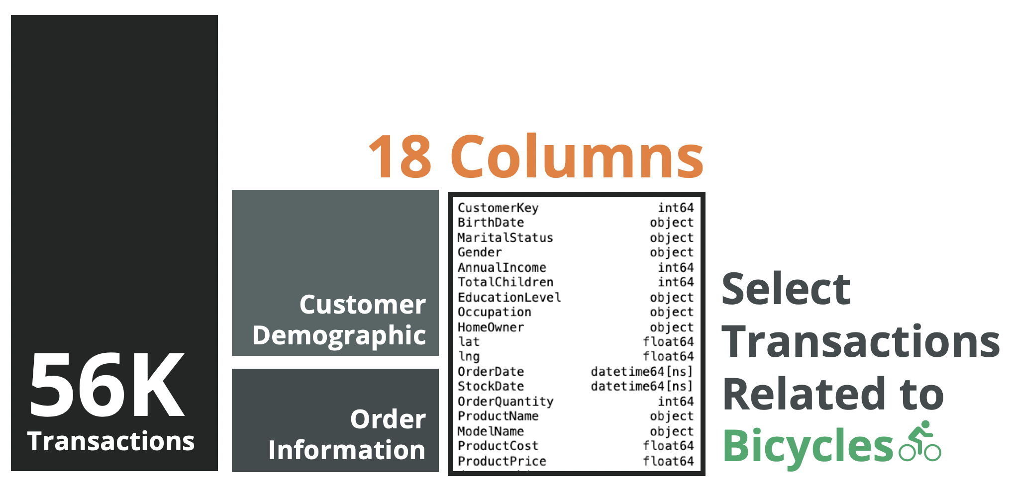
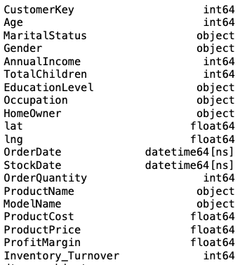
Data Preparation
14,138 ROWS
20 COLUMNS
Transfer Birthdate to Age
Drop Nulls in Gender
Create Profit Margin Column
Winsorization
DONE

Slide 5
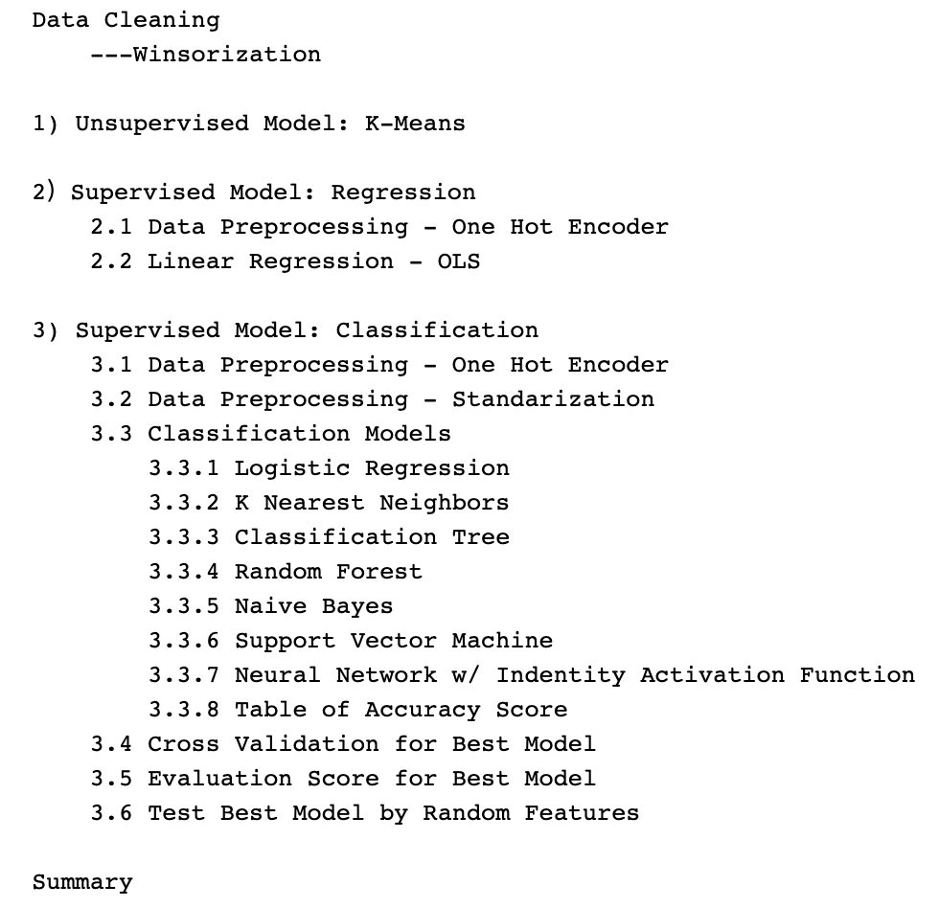
Modeling Techniques
Project Structure
Customer Segmentation
Clustering Analysis
Customer Potential Purchases
Measured by accuracy score
Product Recommendation System
Measured by accuracy score
Using K-Folds
Notes:
How you made various technical decisions (e.g. choice of model, evaluation criteria) and how those choices would affect the solution from a 'business' standpoint o Technical challenges you encountered
Cross validation - K folds

Slide 6
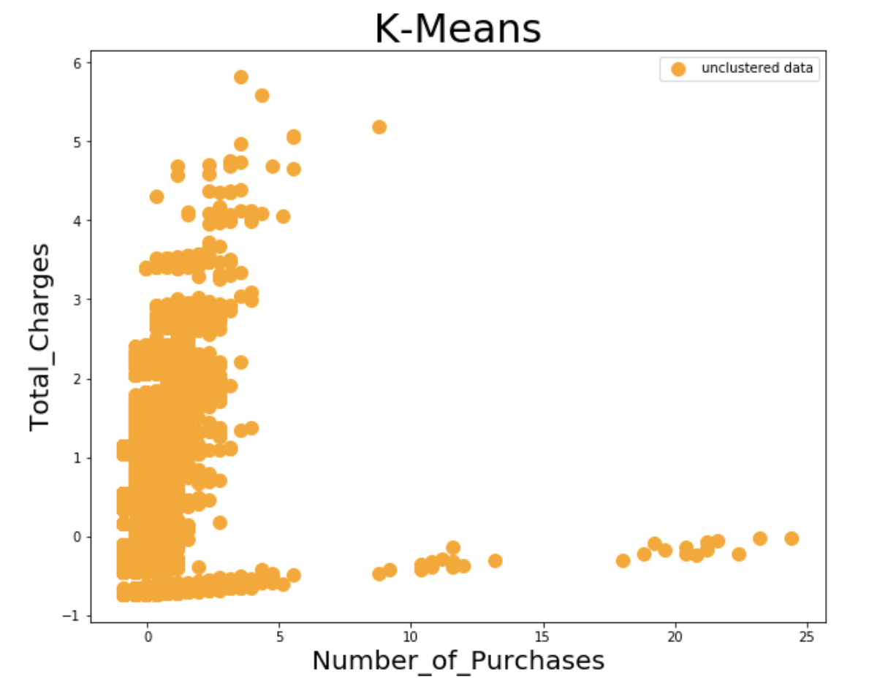
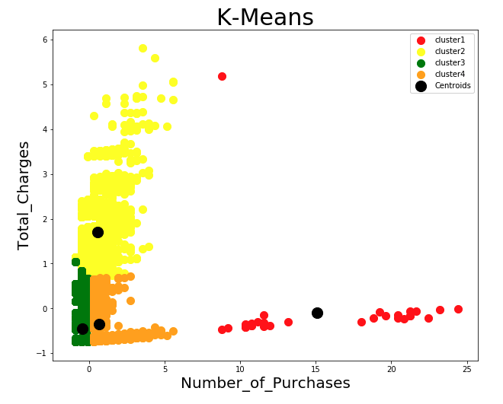
K-Means Graph
Original Dataset
Clustering Dataset

Slide 7
Customer Segmentation – K-Means
We assign label back to each customer and then apply different strategy.
Cluster 1 – Red
Retained Customers: Lower Charges & Higher # of Purchases
Consider outsource option or cut the tail.
Cluster 2 - Yellow
Potential Customers: Higher Charges & Lower # of Purchases
Continue the current customer treatment strategy to provide best CRM service.
Cluster 3 - Green
Hibernators: Lower Charges & Much Lower # of Purchases
Ignite sales via cross-sale or upscale offers and have higher touch and personalization.
Cluster 4 - Orange
Hibernators: Lower Charges & Lower # of Purchases
Ignite sales via cross-sale or upscale offers and have higher touch and personalization.
There is no Loyal Customers, which have higher charges and higher number of purchases these two features, so we should let marketing employee people develop current customers to be Loyal Customers.

Slide 8
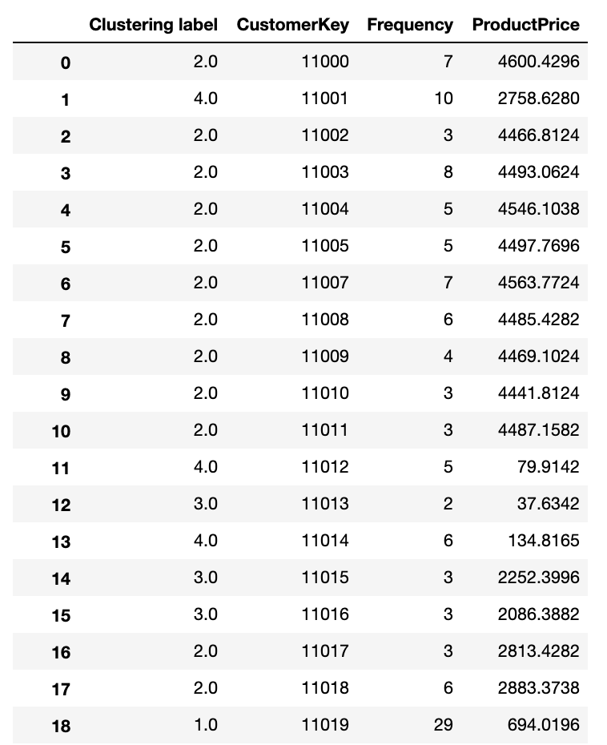
Customer Segmentation – K-Means
We assign label back to each customer and then apply different strategy.
Cluster 1 – Red
Retained Customers: Lower Charges & Higher # of Purchases
Consider outsource option or cut the tail.
Cluster 2 - Yellow
Potential Customers: Higher Charges & Lower # of Purchases
Continue the current customer treatment strategy to provide best CRM service.
Cluster 3 - Green
Hibernators: Lower Charges & Much Lower # of Purchases
Ignite sales via cross-sale or upscale offers and have higher touch and personalization.
Cluster 4 - Orange
Hibernators: Lower Charges & Lower # of Purchases
Ignite sales via cross-sale or upscale offers and have higher touch and personalization.

Slide 9
Profit Margin Prediction – Linear Regression - OLS
We use supervised regression model for predicting the profit margin through linear regression with OLS
Categorical
Numerical
In the future, once we collect such demographic information, we can predict the profit margin brought from prospective customers.
We can also cluster customers into corresponding groups by affordability as well, then apply similar strategies that we did in K-Means.
Marital Status
Gender
Education Level
Occupation
Homeowner
Bike Model Name
Age
Annual Income
Total Children
Latitude
Longitude
OneHotEncoder()
Accuracy
99.93%

Slide 10
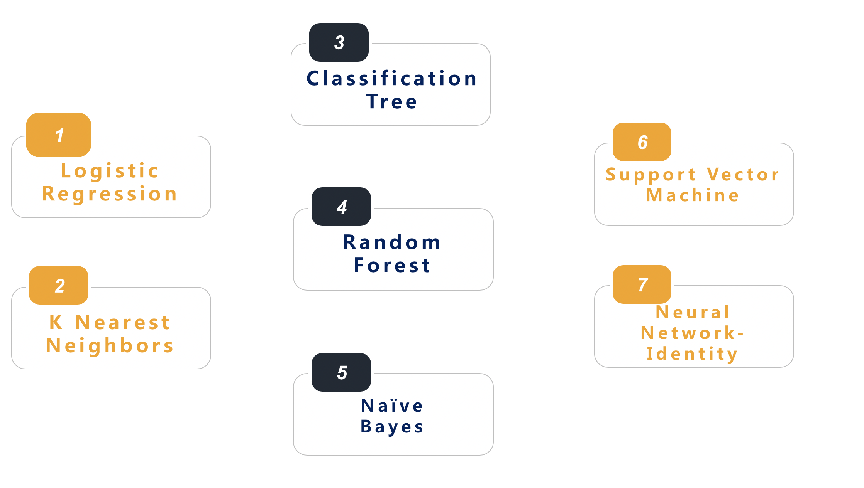
Product Recommendation
We use supervised classification model for predicting model names
Categorical
Marital Status
Gender
Education Level
Occupation
Homeowner
OneHotEncoder()
Numerical
Age
Annual Income
Total Children
Latitude
Longitude
Product Price
StandardScaler()
Notes:
Add features
Numerical with standardization
Categorical with onehotencoder
Re-do a table, accuracy score
The classification outcome we predict is the Model Name. Based on the demographic information, we choose to use Classification Tree. Therefore, for future customers, once we collect such information, we can predict the types of bicycles that is most likely to be bought by given customers. For example, for those customers who purchase expensive bicycles will definitely bring more profits to the company than customers who purchases cheaper one, and we should spend more time providing CRM (Customer Relationship Management) serivce.

Slide 11
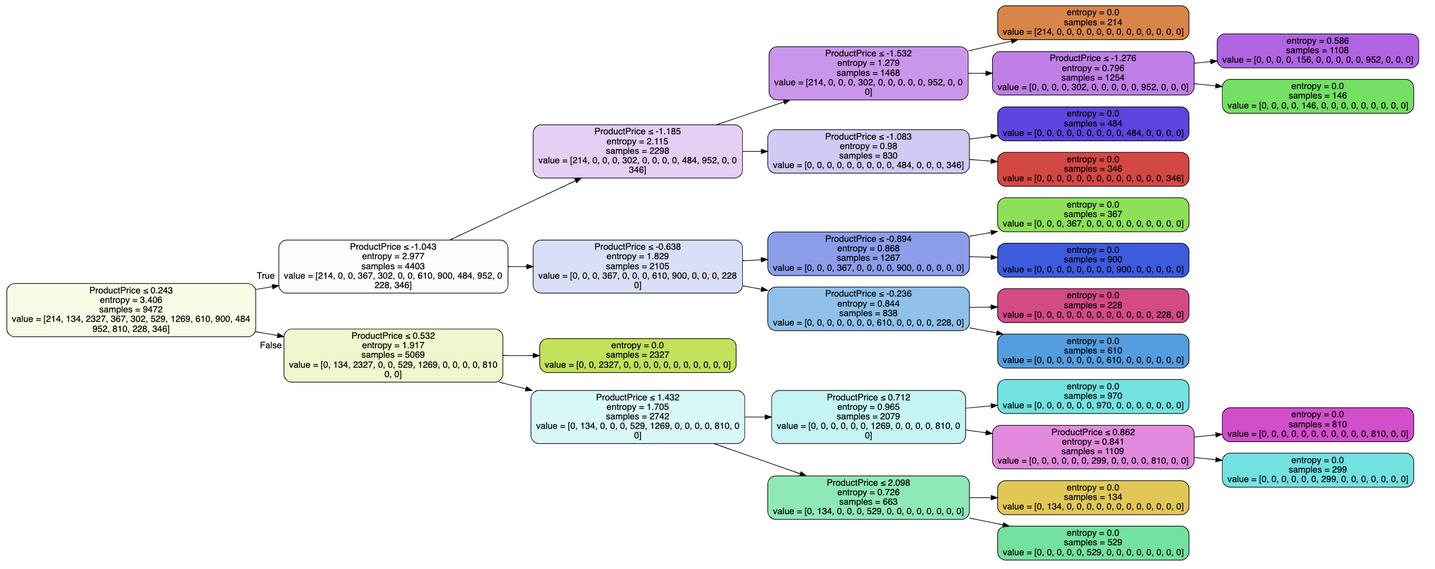
Plot – Classification Tree
Notes:
Add features
Numerical with standardization
Categorical with onehotencoder
Re-do a table, accuracy score
The classification outcome we predict is the Model Name. Based on the demographic information, we choose to use Classification Tree. Therefore, for future customers, once we collect such information, we can predict the types of bicycles that is most likely to be bought by given customers. For example, for those customers who purchase expensive bicycles will definitely bring more profits to the company than customers who purchases cheaper one, and we should spend more time providing CRM (Customer Relationship Management) serivce.

Slide 12
Product Recommendation – Classification Tree
Categorical
Numerical
Classification Model | Accuracy Score
Classification Tree | 98.03%
Naïve Bayes | 98.01%
Neural Network Identity | 94.73%
Random Forest | 85.19%
Logistic Regression | 84.25%
K Nearest Neighbors | 42.48%
Support Vector Machine | 20.60%
Marital Status
Gender
Education Level
Occupation
Homeowner
Age
Annual Income
Total Children
Latitude
Longitude
Product Price
OneHotEncoder()
StandardScaler()
As we can see from above table, for classification model, we should choose Classification Tree as the accuracy score of this model is the highest one compared to others.
KNN and SVM have poor accuracy because the algorithm of these two is calculating distances and finding hyper-plane, but the algorithm of Naive Bayes and Decision Tree is calculating probability.
Notes:
Add features
Numerical with standardization
Categorical with onehotencoder
Re-do a table, accuracy score
The classification outcome we predict is the Model Name. Based on the demographic information, we choose to use Classification Tree. Therefore, for future customers, once we collect such information, we can predict the types of bicycles that is most likely to be bought by given customers. For example, for those customers who purchase expensive bicycles will definitely bring more profits to the company than customers who purchases cheaper one, and we should spend more time providing CRM (Customer Relationship Management) serivce.

Slide 13
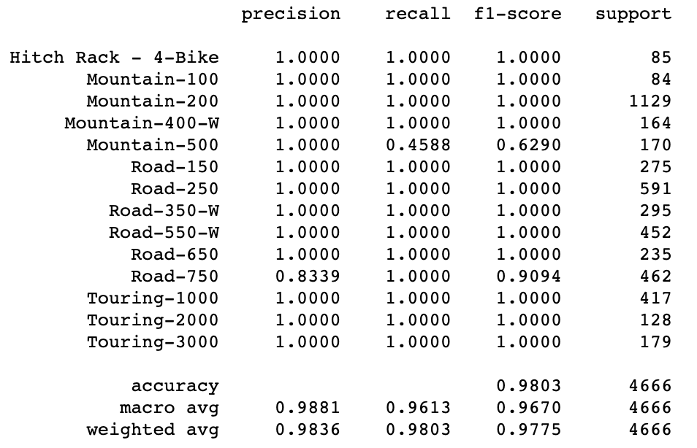
Further Action for Best Model – Classification Tree
Cross Validation: K-Fold increases accuracy score a little bit.
Evaluation Score for Best Model

Slide 14
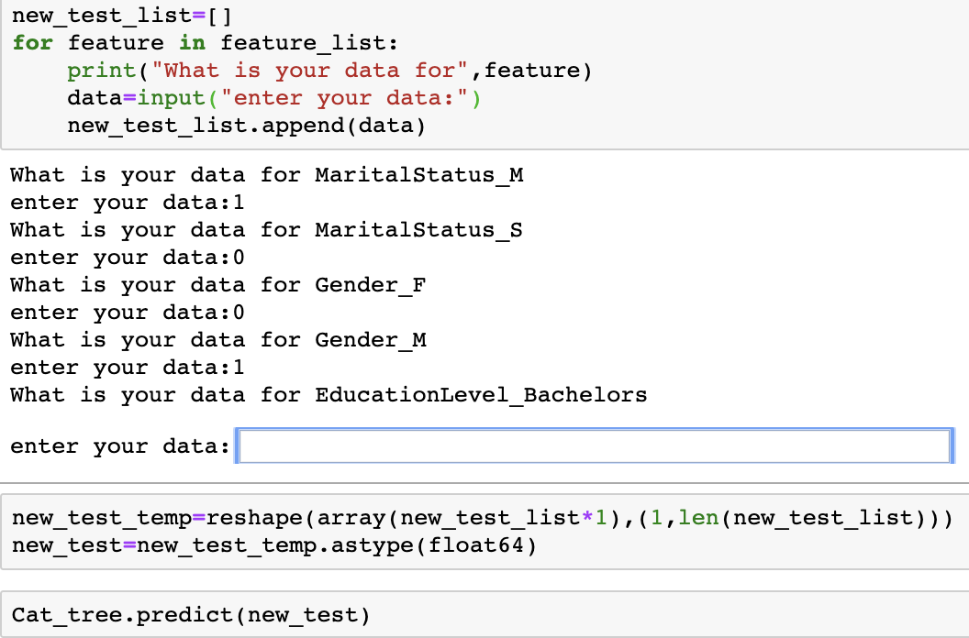
Test Best Model by Random Features
Type from Keyboard:
Please enter 1 if given feature exists and 0 otherwise for categorical features.
Please enter z-score for numerical features ‘Age’, ‘Annual Income’, etc.
Processing Method:
For Gender,
If we have Female, enter 1
If we do not have Male, enter 0
Keep following the above rules until there is no such entering keyboard.

Slide 15

Business Application
A quick showcase of how the model works in a business context
Here is John Smith:
34-year middle class, married, 2 kids, has a bachelor’s degree. Currently living in an owned house and working in SoCal.
From the demographic info, we predicted that John is likely to purchase our Touring-1000 Bike, with a profit margin around $1000.
We would have a salesperson drafting a personalized email with incentives to purchase this bike.

Slide 16
Supervised Model - Classification
Based on the demographic information, we can use Classification Tree to predict Model Names.
Therefore, in the future, once we collect such information, we can predict model names of bicycle that are most likely to be bought by prospective customers.
For Example:
Those customers who purchase expensive bicycles will bring more profits to the company than customers who purchase cheaper ones, and we should spend more time providing CRM (Customer Relationship Management) service.

Slide 17
Deployment & Next Steps
The results are successful so here are how we deploy and some potential issues.
1
Deployment
Pickle File
2
Technical
Issues
3
Ethical
Consideration
Save the fit model as a pickle file then upload it online.
Others can now load this “pickled” object.
Same features can be passed to the model and get prediction results.
Technically difficult to upload and create APIs with good usability.
There is possibility of leaking customers’ private information when we upload and publish the model online since almost all features are private information.
Scope for future work: with number of customers growing, our model needs to be adjusted.
Notes:
you can save the fit model to disk as a pickle file and you can upload it online. Then someone else can load this "pickled" object into their software and as long as they pass the same set of features in to your model, they can get predictions from the model you trained.
Issues: technical difficulty to learn how to upload
Ethical consideration: leak customer private info
Scope for future work: with more customer in the future, our models needs to be propagated
https://www.analyticsvidhya.com/blog/2017/09/machine-learning-models-as-apis-using-flask/

Slide 18
Challenges
From a technical and business perspective:
1
Struggled with using for-loop with iterations during data cleaning.
2
When we clustered using K-Means, feature selection was hard as we were choosing between either age - product_price vs. frequency - total_charges.
3
3
There are many small-amount transactions in the dataset, but we only used large-amount transactions, so the size of the dataset was decreased by 60% and may have bias.
4
Notes:
Challenges:
During data-cleaning, for loop with iterations very hard
Learn lambda functions
K-Means features selection is difficult: age-production price, frequency-total charge.
Data Challenge/Limits:
Many small-amount transactions but we only used large transactions (bike purchases) to avoid sample that is not representative. Decreased data size by 60%.
Other Work:
customer segmentation using K-Means may not make any sense
Each dataset has a different best model,
Deep learning and neural network are the updated version and approach to promote simple models as they have much many hidden layers and back-propagation can automatically reduce errors.

Slide 19
Limitations
Different techniques and approaches we might take if were to do it again or had more time
1
The accuracy score of Random Forest is lower than Decision Tree model’s, which seems counter-intuitive.
2
In future work, we could implement feature selection schemes and do a PCA (principle component analysis).
Notes:
Challenges:
During data-cleaning, for loop with iterations very hard
Learn lambda functions
K-Means features selection is difficult: age-production price, frequency-total charge.
Data Challenge/Limits:
Many small-amount transactions but we only used large transactions (bike purchases) to avoid sample that is not representative. Decreased data size by 60%.
Other Work:
customer segmentation using K-Means may not make any sense
Each dataset has a different best model,
Deep learning and neural network are the updated version and approach to promote simple models as they have much many hidden layers and back-propagation can automatically reduce errors.

Slide 20
Summary
We successfully built up customer segments using unsupervised model through K-Means.
We were able to predict the profit margin using supervised regression model through Linear Regression with Ordinary Least Square.
We were able to predict product model names using supervised classification model through Classification Tree.

Slide 21


